Slide 1
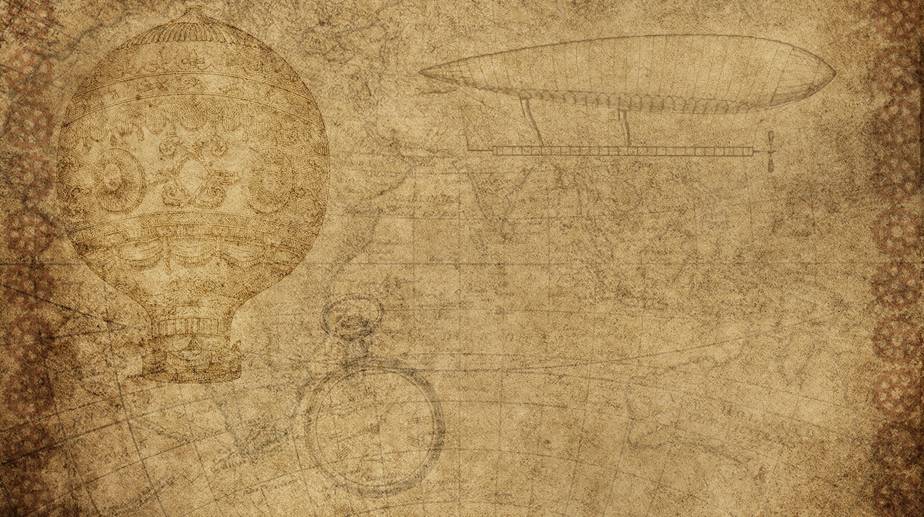

Exoplanet simulator
By saMMARTH KUMAR

Slide 2

exoplanet simulator
I was very interested in astronomy and exoplanets fascinated me in particular
With the evolution of computer science, algorithms for identifying and confirming exoplanets are being made and I wanted to contribute to that
Hence I came up with this simulator.

Slide 3

Who will use my invention
For now, the Simulator is a small scale model., but the logic behind my algorithm can be potentially used in the field of astronomy and astrophysics to detect exoplanets and identify their periodicity.
It is a useful tool for demonstrating the mechanisms of an exoplanet

Slide 4

Invention Materials
Wood base
Arduino MEGA
Electrical components(wire, LED, motor)
Other small pieces (plastic, hot glue)
I chose these materials because they are relatively cheap and were mostly recyclable. The wood, plastic and some components (such as motors) were recycled

Slide 5


Invention design process
Talk about the design process
I started with a mechanical model of an exoplanet revolving around the star with a light sensor inputting the values of brightness it read.
After experimenting with the prototype, I created an algorithm which would measure the periodicity of changes in dips of light and determine whether it was a planet or not
It took several tries to perfect the algorithm and there is still scope of improvement
<Insert pictures or drawings of your invention design/building process>
*you can insert a new slide for these pictures/drawings if you need to!

Slide 6

My Invention in Use!
Since I created the invention foe the purpose of the URJA Science Exhibition, this is the first time I am displaying it.
Here are some of the highlights of my journey:
Starting from scratch
Work in progress
Final product

